Slide 1


Transportation Modeling using GMNS standard, Open-Source AMS Tools
Developed through an early FHWA project: Effective Integration of Analysis, Modeling, and Simulation Tools
AMS DATA HUB CONCEPT OF OPERATIONS:
https://www.fhwa.dot.gov/publications/research/operations/13036/004.cfm
General Modeling Network Specification (GMNS): https://github.com/zephyr-data-specs/GMNS
Xuesong (Simon) Zhou (xzhou74@asu.edu)
https://github.com/asu-trans-ai-lab
https://asu-trans-ai-lab.github.io/website_openlayer_4GMNS/
School of Sustainable Engineering and the Built Environment
Arizona State University

Slide 2


Inclusive Excellence
https://inclusion.asu.edu/

Slide 3
Outline
1. Motivation
2. Integrated Modeling
3. Datahub
4. Connections to transportation Analaysis, Modeling and Simulation (AMS)
5. Large scale applications

Slide 4
1. Motivations
Adopting open network standard of GMNS
General Travel Network Format Specification is a product of Zephyr Foundation, which aims to advance the field through flexible and efficient support, education, guidance, encouragement, and incubation. Further details can be found in
https://zephyrtransport.org/projects/2-network-standard-and-tools/
Integrated graphic user interface and analysis package
(1) Provide an open-source code base to enable transportation researchers and software developers to expand its range of capabilities to various traffic management application.
(2) Present results to other users by visualizing time-varying traffic flow dynamics and traveler route choice behavior in an integrated environment.
(3) Provide a free, educational tool for students to understand the complex decision-making process in transportation planning and optimization processes.

Slide 5
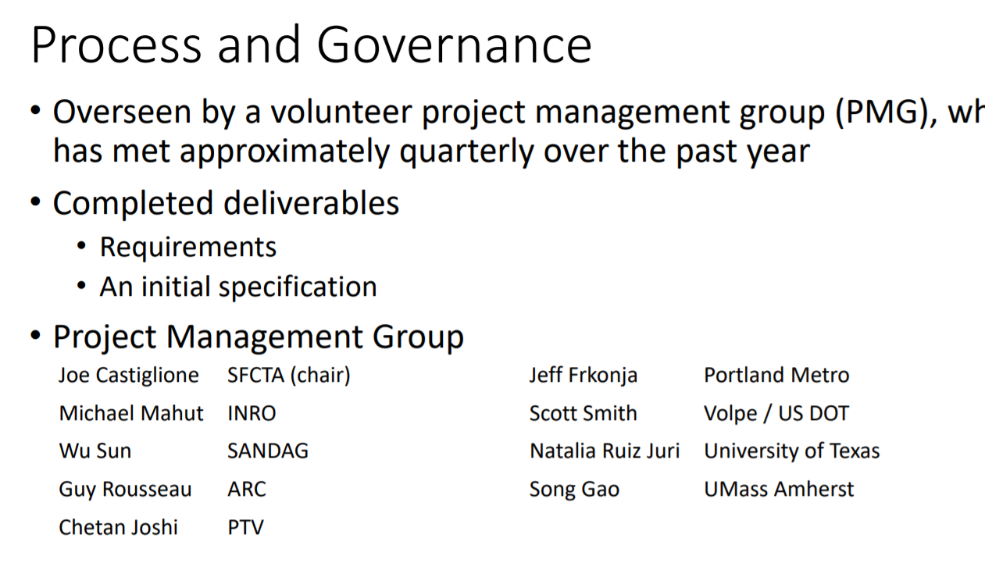
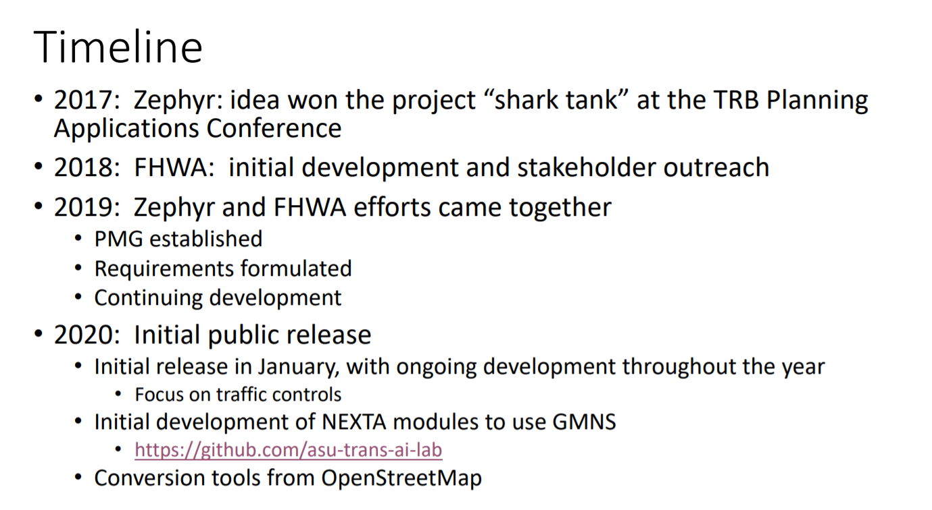
GMNS
USDOT Volpe Center team
Scott.Smith@dot.gov
Ian.Berg@dot.gov

Slide 6
1. Motivations
Our goals
Simplified data input from static traffic assignment
Use parallel computing capability, simplified routing and simulation
Open-source
Existing technical barriers: (based on DTA user survey, TRB network modeling committee, 2009)
Require too many input data: 47%
Take too long to run: 35%
Model is unclear: 35%
Visualization: Seeing is believing
Excel Tools: Start from basics

Slide 7
Our Vision
With Analysis, Modeling and Simulation (AMS) Data Hub Systematic
Current Practice Ad Hoc
Field Data
Optimizing scheduling and routing, Safety & Emissions Models
HCM & Signal Timing Models
Micro-simulation Models
Dynamic Traffic Assignment Models
Travel Demand Forecasting Models
Data Hub
Big Data
Multimodel Optimization
&
Scheduling and Routing
Highway Capacity & Signal Timing Models
Micro-simulation Models
Traffic Stream Model &Dynamic Assignment Models
Travel Demand Forecasting Models
AMS Data Hub

Slide 8
Data hub 0: Network
Based on GMNS data format
node, link, movement
https://github.com/zephyr-data-specs/GMNS
Regional planning models through GIS shape files
TransCAD
CUBE
VISUM
Export network to GIS
Subarea cut utility
Micro-simulation Models
Traffic Stream Model &Dynamic Assignment Models
Travel Demand Forecasting Models
AMS Data Hub
Highway Capacity & Signal Timing Models
Multimodel Optimization&
Scheduling and Routing
Big Data

Slide 9
Building 4-step Model For Your Campus Using Open-source Tool And GMNS
B. Demand
A. Network
4. Grid2Demand
1. OSM2GMNS
zone.csv, demand.csv
OSM file
2. net2cell
macro, meso and micro networks
C. Simulation
5.A/B Street
MATSIM, AequilibraE
UMD AgBM
OpenAMOS
DTALite
3. signal2timing
Signal timing

Slide 10
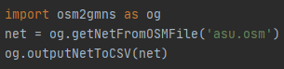
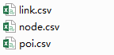
0.1 Open-Source Network Downloader
OSM2GMNS
Features
1) Easy to use, two lines of python code
2) Multimodal support (drivable, walkable, bikeable roads; railway; aeroway)
3) Network files in GMNS format
4) Transportation network modelling (intersection consolidation; point of interest)

Slide 11
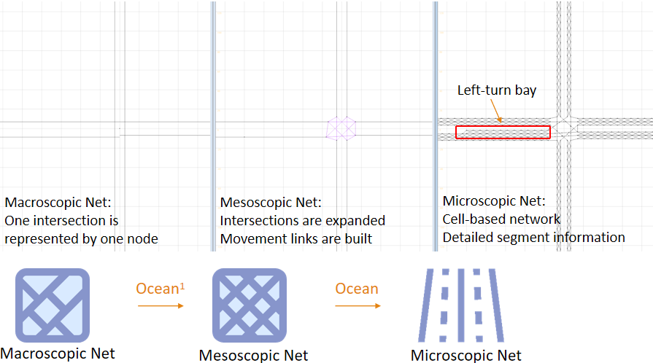
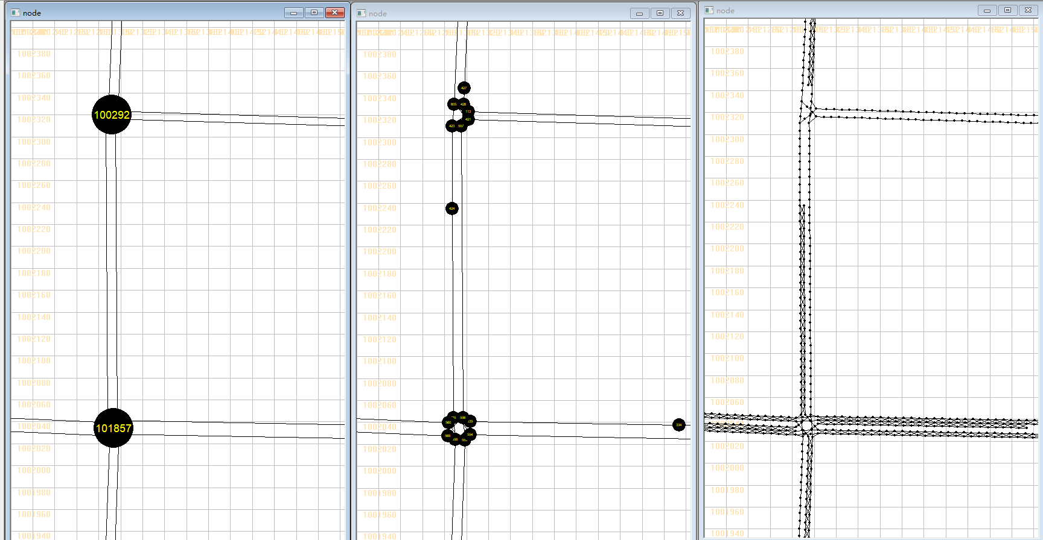
0.2 Multi-Level Network Convertor
https://pypi.org/project/net2cell/
Open-source tool for creating cell-based (microscopic) and mesoscopic networks
Macroscopic Network
Mesoscopic Network
Microscopic Network

Slide 12
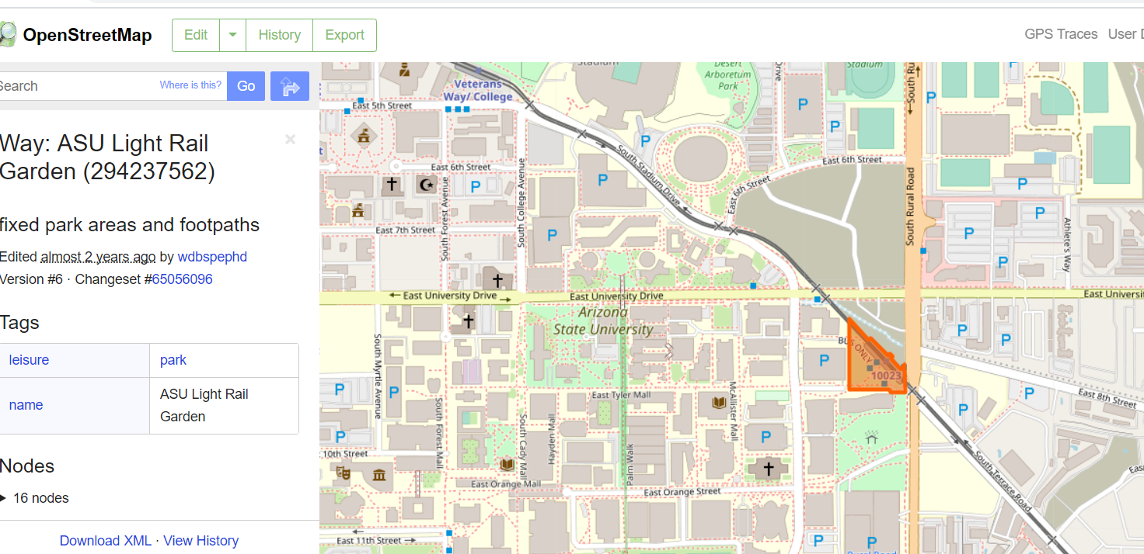
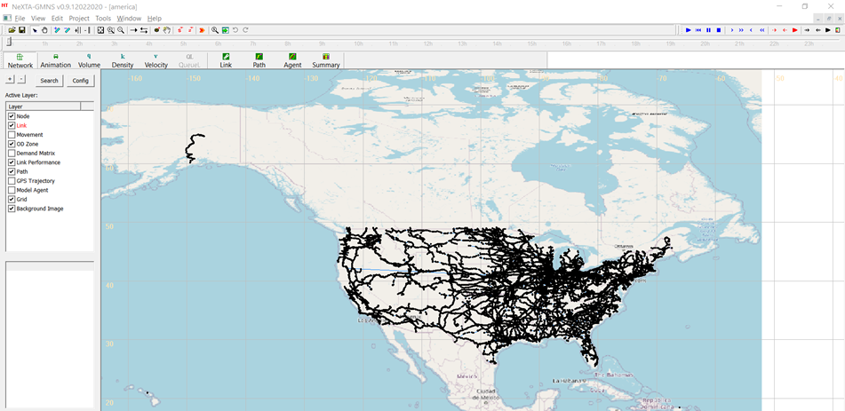
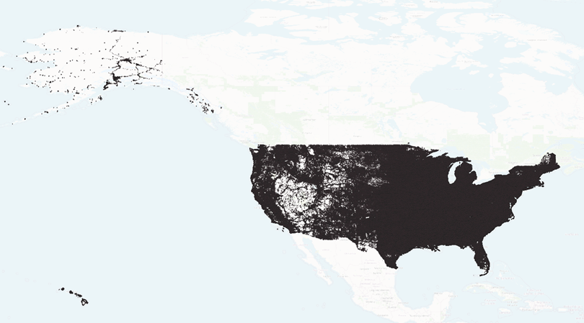
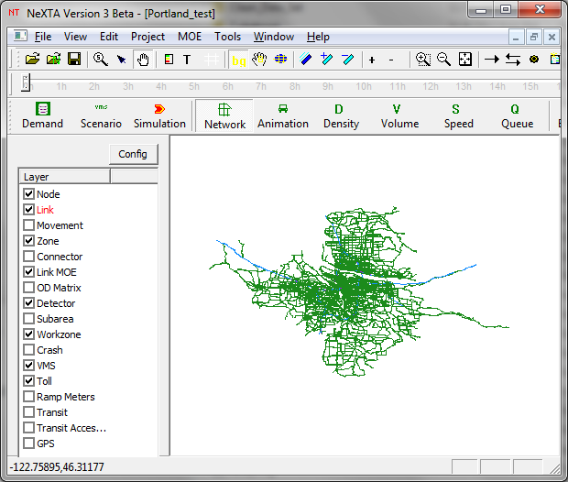
Openstreet Map Data Importing
Import node/link/zone shape to GMNS https://pypi.org/project/osm2gmns/
Openstreet Map
US rail network from OSM with 0.5M nodes
Handling Large-scale map
US driving network from OSM with 20M nodes
Converted by OSM2GMNS

Slide 13
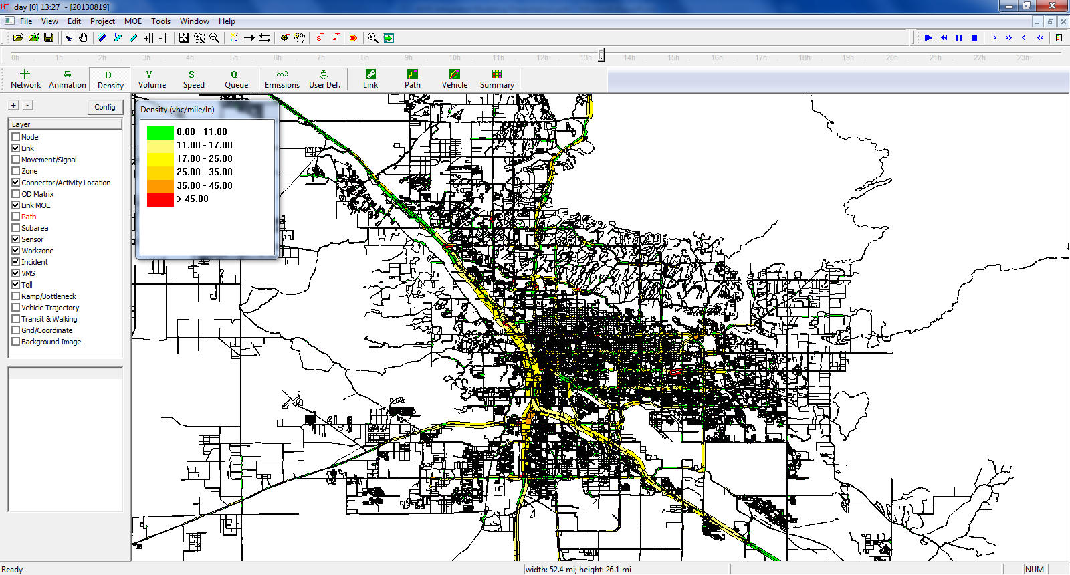
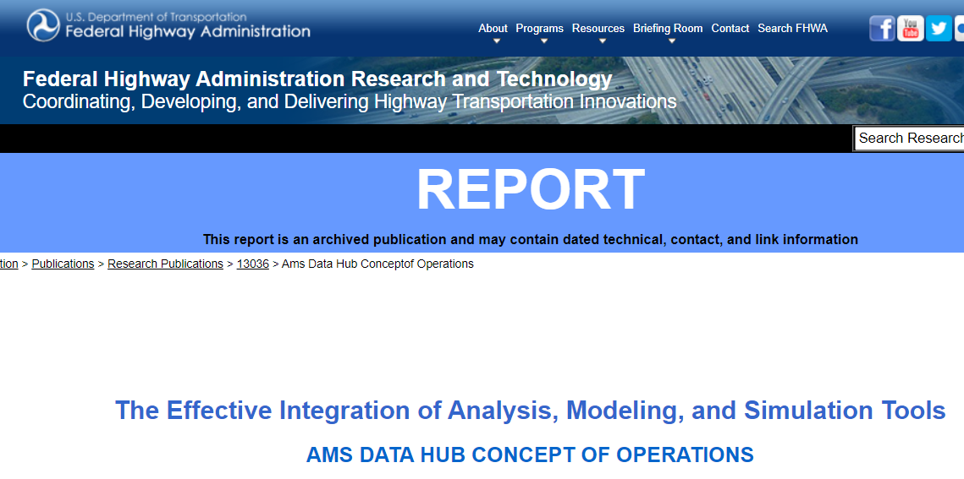
AMS Data Hub Software Prototype: NeXTA
Start with GIS with multiple transportation layers
1. node,
2. link,
3. agent,
4. trajectory,
5. signal timing.
https://github.com/xzhou99/NeXTA-GMNS
Focus on data processing and visualization
https://www.fhwa.dot.gov/publications/research/operations/13036/004.cfm

Slide 14
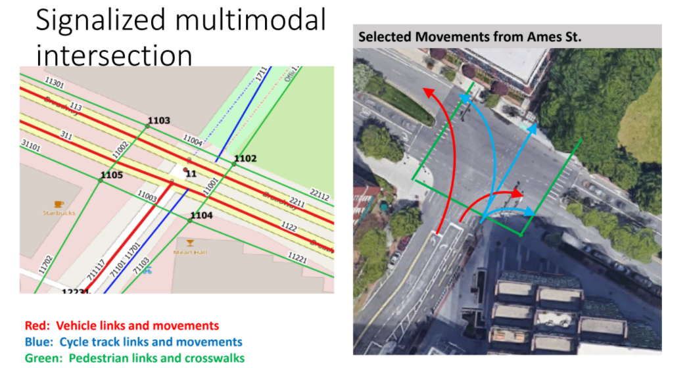
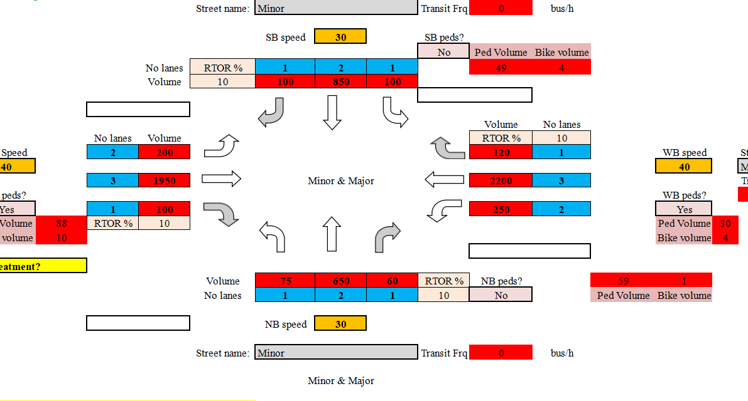
0.3 Signal Timing Generation Tool
Excel-based and Python based
https://github.com/milan1981/Sigma-X
HCM-based computational engine for signalized intersections

Slide 15
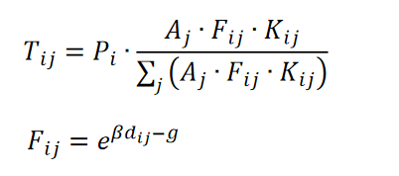
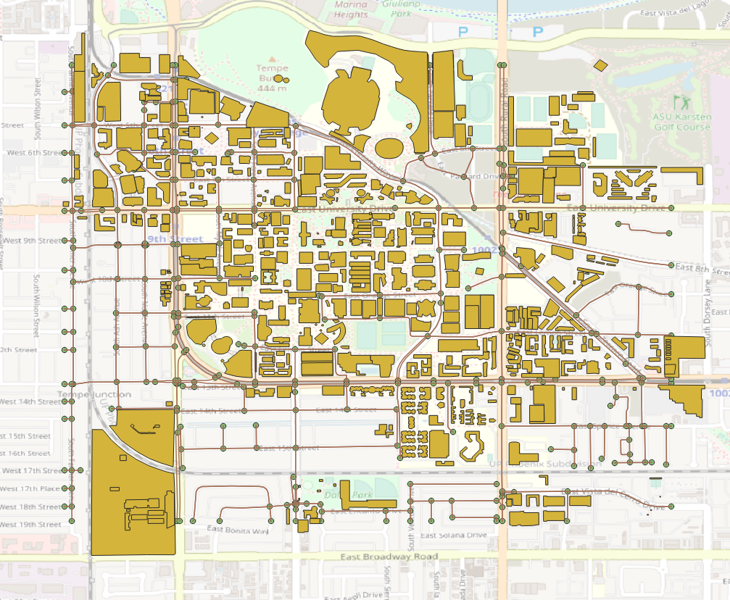
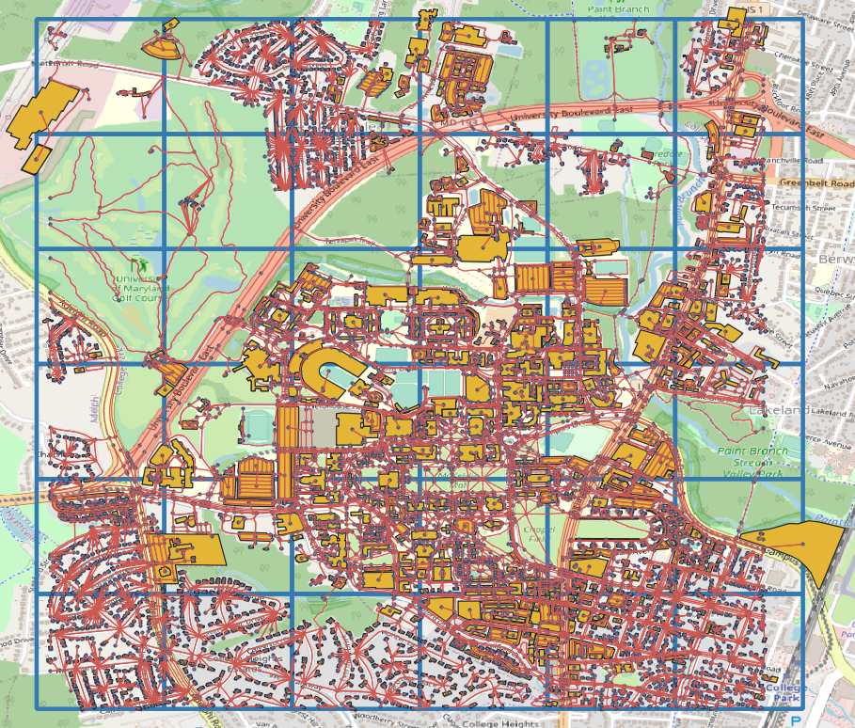
0.4 Demand Generation
Grid2Demand
https://pypi.org/project/grid2demand/
Input: POI geometry production, attraction information, POI type
Intermediate: accessibility matrix
Output: zone.csv, demand.csv

Slide 16
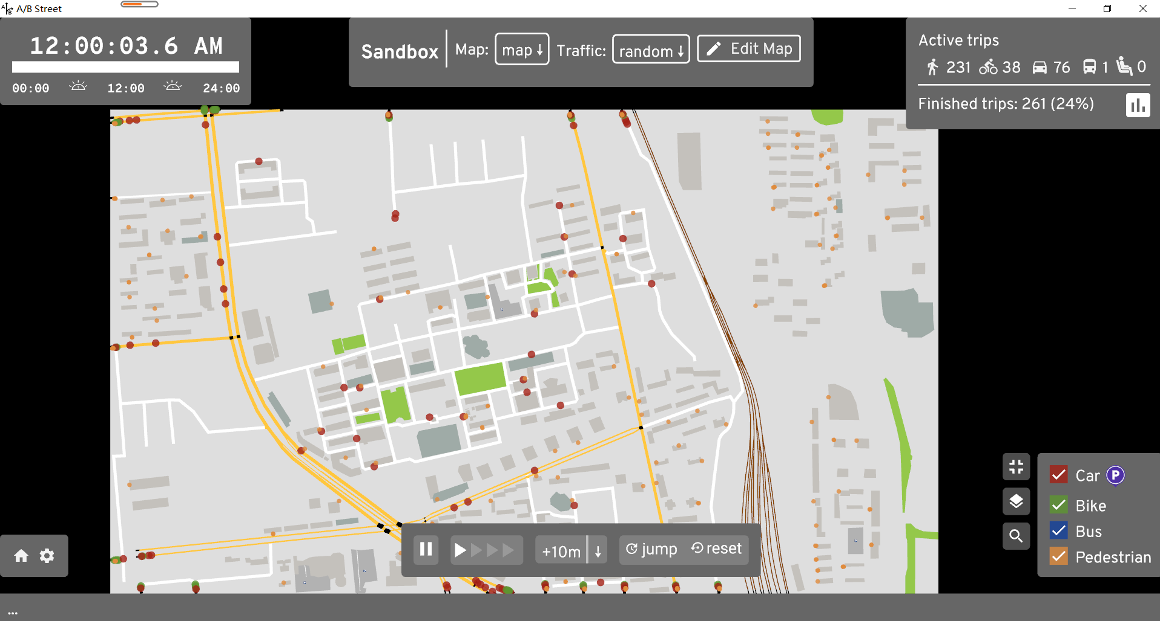

Simulation/Assignment --> Learn Other Educational Resource From ABD30
Download and run.
Select map

Slide 17
General Transit Feed Specification (GTFS)
Import GTFS to node/link data to GMNS data format (NeXTA-> menu -> import GTFS)

Slide 18
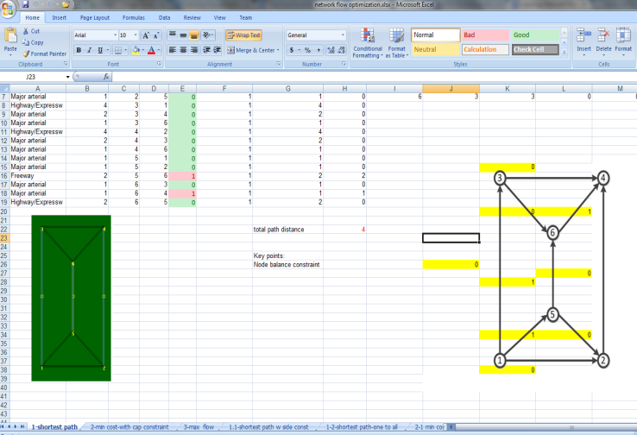
Use of network data: Shortest Path Finding, Network Flow Model
https://github.com/xzhou99/learning-transportation/blob/master/GAMS_code%20-space-time-network/Assignment_2_LearningNetworkFlowOptimizationinExcelandGLPKSolvers.docx

Slide 19
Connection 1: Big Data
Big Data
Multimodel Optimization
&
Scheduling and Routing
Highway Capacity & Signal Timing Models
Micro-simulation Models
Traffic Stream Model &Dynamic Assignment Models
Travel Demand Forecasting Models
AMS Data Hub
Sensor data (link_performance.csv)
15-min speed or count
GPS trajectory data (trajectory.csv)
NGSIM trajectory data set
https://github.com/xzhou99/NeXTA_4_NGSIM_Trajectory_Visualization
BHL sensor data set
I-405 data set from PeMS (to do)

Slide 20
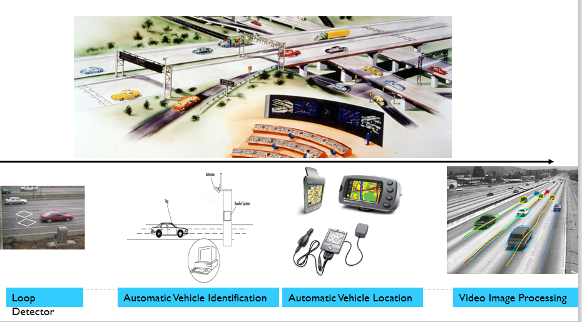
Big data for integrated traffic management

Slide 21
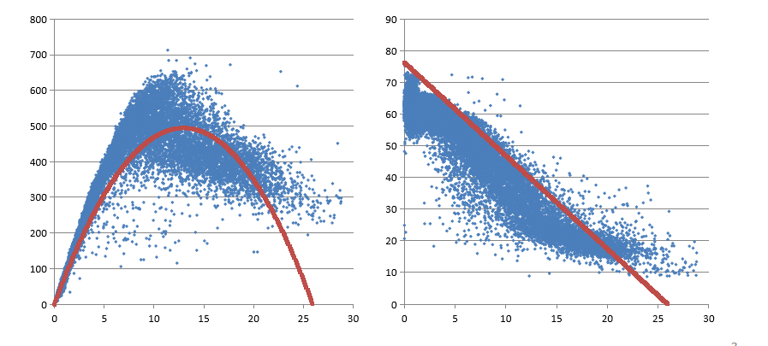
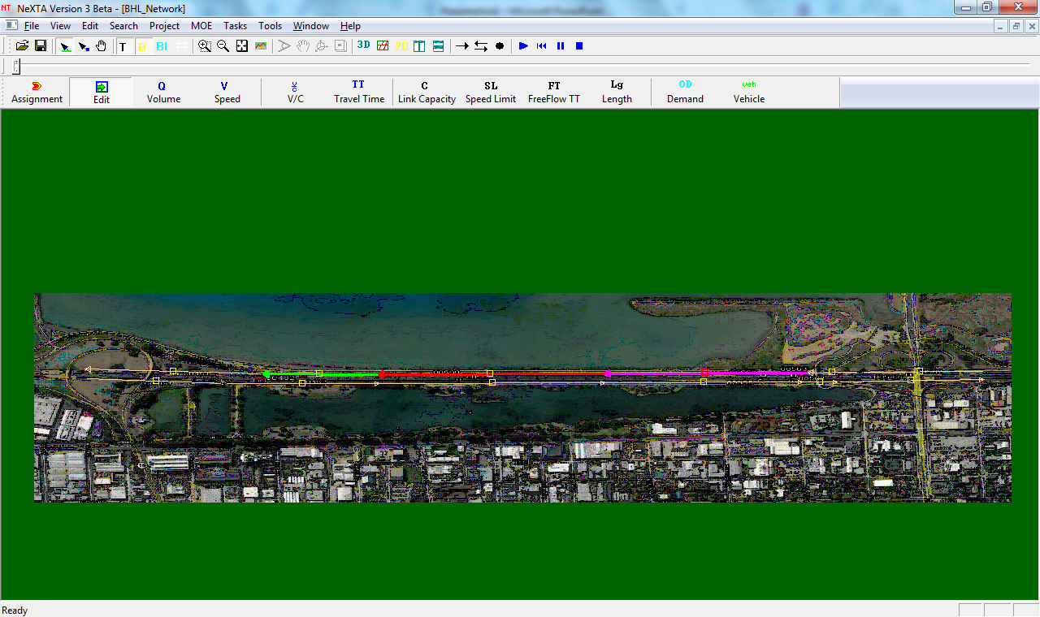
1.1 Understand QKV relationship from aggregated sensor data
Berkeley Highway Laboratory (BHL) sensor data set
https://github.com/xzhou99/stalite-dtalite_software_release/tree/gh-pages/learning_document/4_highway_capacity_traffic_stream_model/BHL-Network

Slide 22
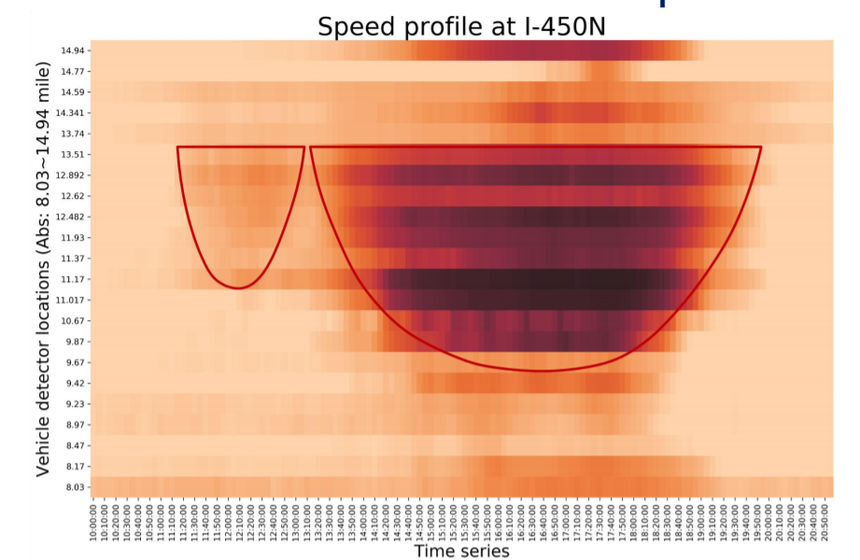
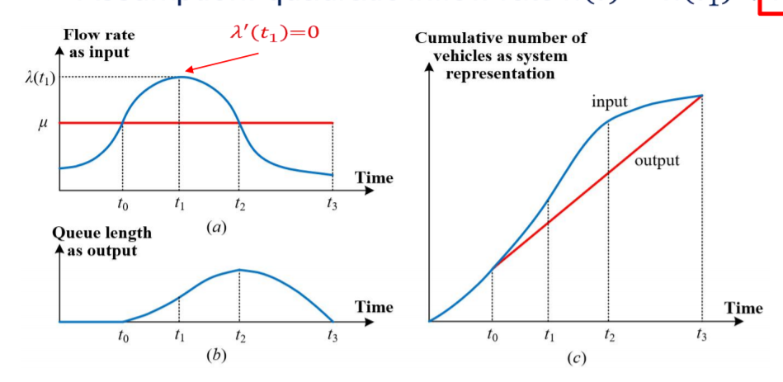
1.2 Understand capacity and bottleneck
https://github.com/xzhou99/stalite-dtalite_software_release/tree/gh-pages/learning_document/4_highway_capacity_traffic_stream_model

Slide 23
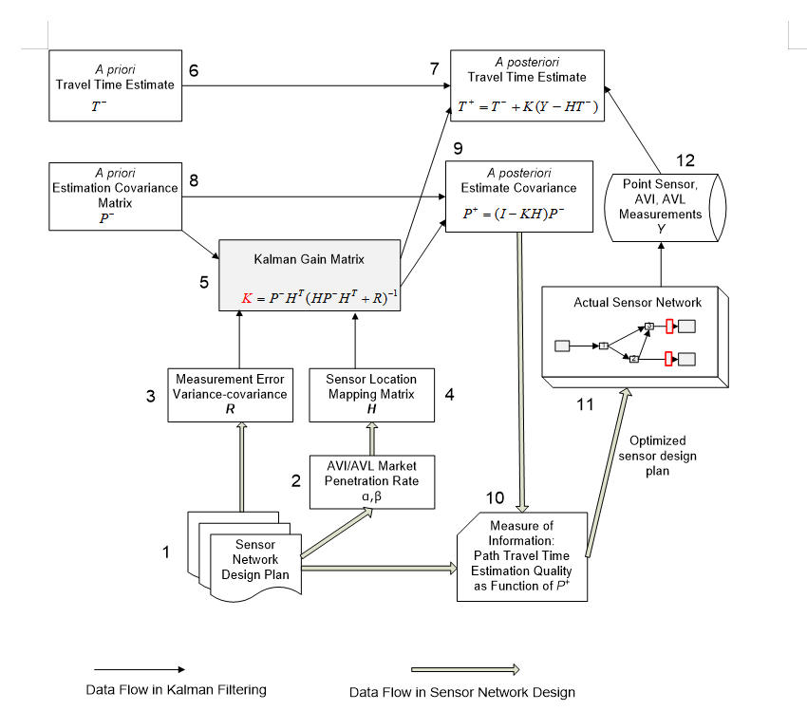
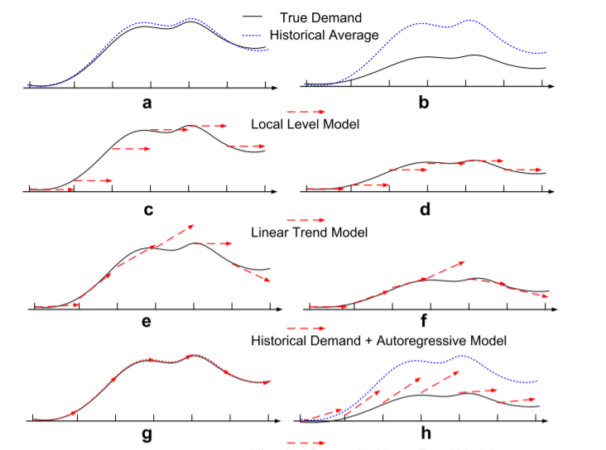
1.3 Understand traffic state estimation and prediction
https://github.com/xzhou99/stalite-dtalite_software_release/tree/gh-pages/learning_document/4_highway_capacity_traffic_stream_model/Learning_KalmanFiltering_for_travel_state_estimation_prediction

Slide 24
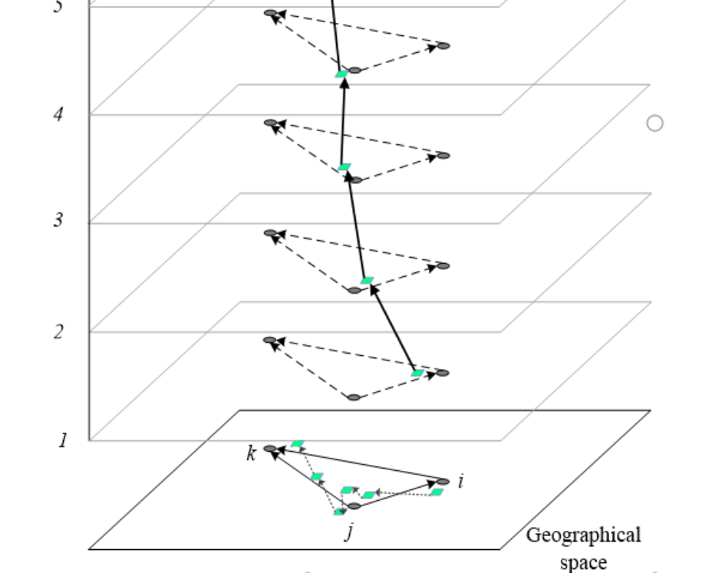
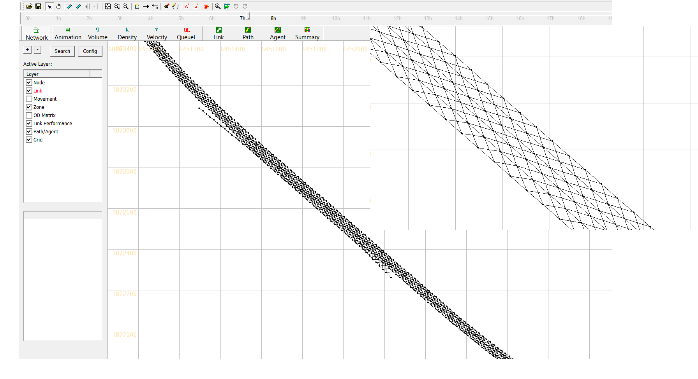
1.4 Map matching based on space-time paths and a time geographic method
https://github.com/xzhou99/space-time-network-based-map-matching

Slide 25
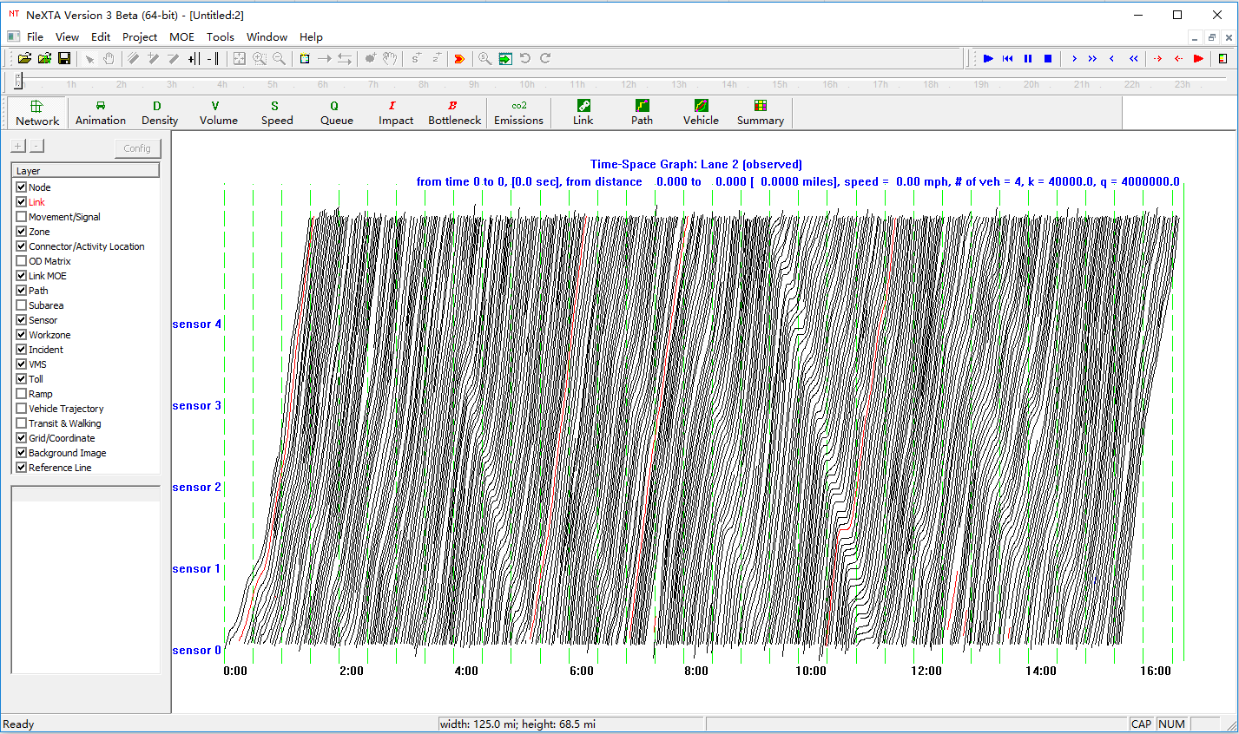
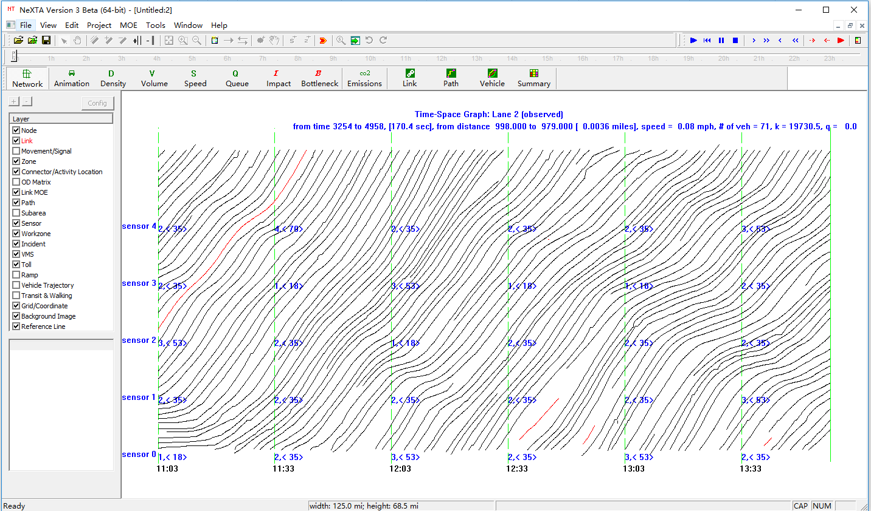
1.5 Analysis of Trajectories from NGSIM

Slide 26
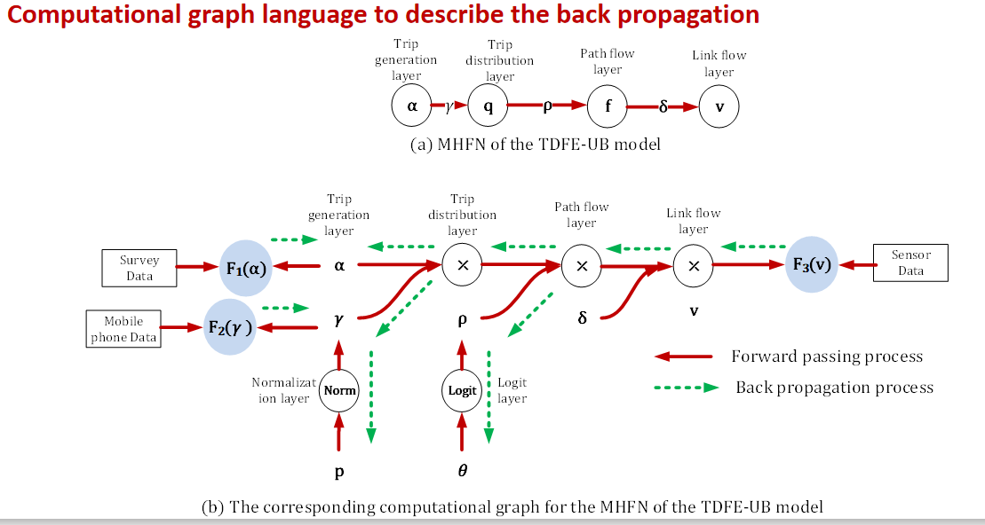
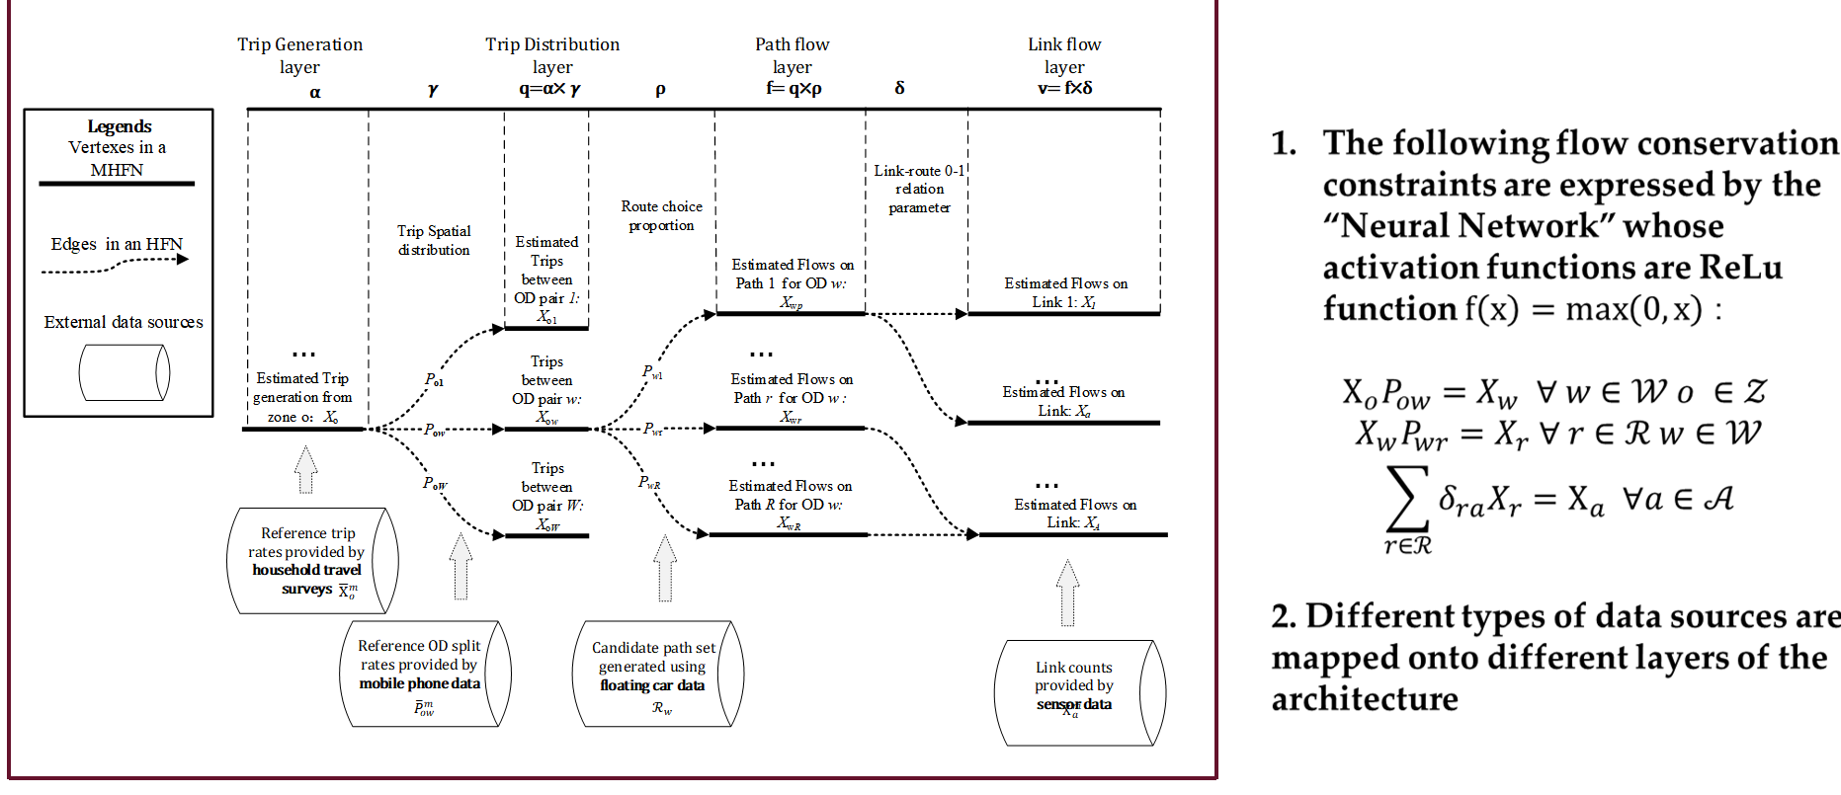
1.6 Integrate deep learning methods with transportation modeling
https://github.com/xzhou99/TCGLite

Slide 27
Connection 2: Travel demand model
Trip generation, distribution and model choice
Static Traffic Assignment
OD destimation using multiple data sources
Layout and land use
Big Data
Multimodel Optimization
&
Scheduling and Routing
Highway Capacity & Signal Timing Models
Micro-simulation Models
Traffic Stream Model &Dynamic Assignment Models
Travel Demand Forecasting Models
AMS Data Hub

Slide 28
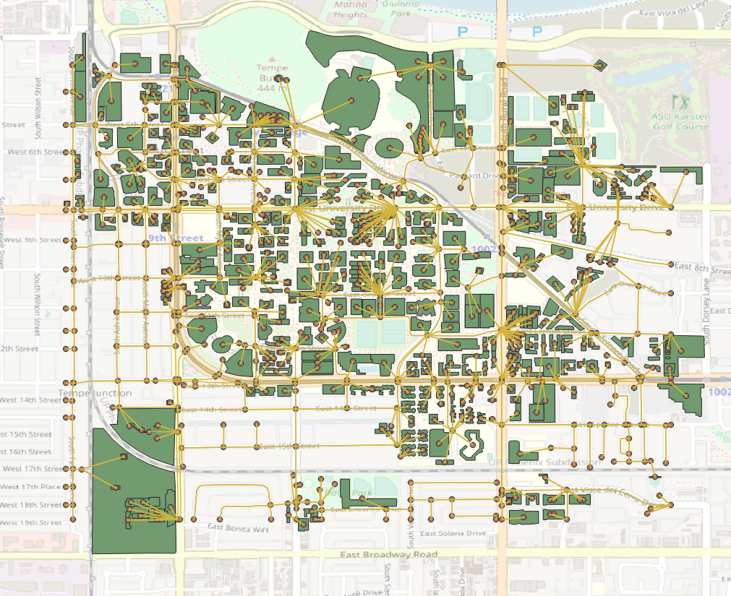
2.1 Trip generation, distribution and model choice
Grid2Demand
A quick trip generation and distribution tool
4-step trip generation
Input: POI geometry production, attraction information, POI type
Output: zone.csv, demand.csv
https://github.com/asu-trans-ai-lab/grid2demand
Mode choice model
https://github.com/xzhou99/stalite-dtalite_software_release/tree/gh-pages/learning_document/6_trip_generation/mode_choice
POI mapping from OSM

Slide 29
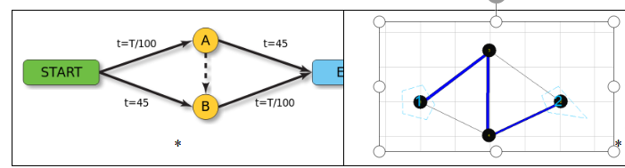
2.2 Static Traffic Assignment
Static traffic assignment GAMS
https://github.com/xzhou99/learning-transportation/tree/master/GAMS_code%20-space-time-network/2%20traffic_assignment
Static traffic assignmetn using STALite
https://github.com/xzhou99/stalite-dtalite_software_release/tree/gh-pages/learning_document/2_static_user_equilibirum

Slide 30
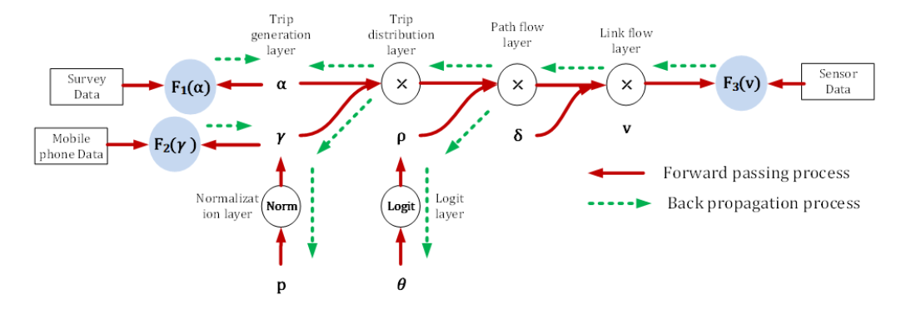
2.3 OD Demand Estimation
Static OD demand estimation using STAlite
https ://github.com/xzhou99/stalite-dtalite_software_release/tree/gh-pages/learning_document/7_ODdemand_estimation
ODME using GAMS
https ://github.com/xzhou99/ODME
Computational graph based demand estimation model using multiple data sources
https://github.com/xzhou99/TCGLite

Slide 31
Connection 3: Traffic Stream Model and Dynamic Assignment
Dynamic user equilibrium assignment method
Model queue spillback
Consider traffic flow dynamics
GAMS for dynamic traffic assignment
https://github.com/xzhou99/learning-transportation/tree/master/GAMS_code%20-space-time-network/2%20traffic_assignment
DTALite/STALite
https:// github.com/xzhou99/DTALite-python
https://github.com/xzhou99/stalite-dtalite_software_release
Learning document
https://github.com/xzhou99/stalite-dtalite_software_release/tree/gh-pages/learning_document/3_dynamic_user_equilibrum_and_traffic_bottleneck
Big Data
Multimodel Optimization
&
Scheduling and Routing
Highway Capacity & Signal Timing Models
Micro-simulation Models
Traffic Stream Model &Dynamic Assignment Models
Travel Demand Forecasting Models
AMS Data Hub

Slide 32
Connection 4: Microsimulation Models
Big Data
Multimodel Optimization
&
Scheduling and Routing
Highway Capacity & Signal Timing Models
Micro-simulation Models
Traffic Stream Model &Dynamic Assignment Models
Travel Demand Forecasting Models
AMS Data Hub
https://github.com/xzhou99/NeXTA_4_NGSIM_Trajectory_Visualization
Multi-resolution network convertoer: Ocean
https://github.com/jiawei92/Ocean
CAVLite
https://github.com/jiawei92/CAVLite

Slide 33
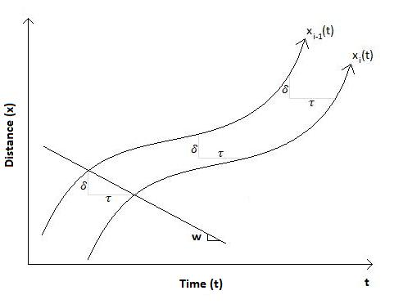
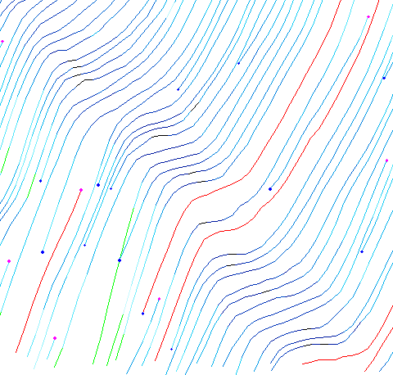
4.1 Understand driving behavior
Underststand microscopic car following model
https://github.com/xzhou99/DTW_Vehicle_Trajectory_Data
https://github.com/xzhou99/Basic_DTW_Matlab
Reaction distance/spacing δ
Reaction time lag τ
W = δ/ τ

Slide 34
Connection 5: Capacity Analysis Tools
Big Data
Multimodel Optimization
&
Scheduling and Routing
Highway Capacity & Signal Timing Models
Micro-simulation Models
Traffic Stream Model &Dynamic Assignment Models
Travel Demand Forecasting Models
AMS Data Hub
HCM-based Quick Estimation Method (QEM)
Given turning volume,
Generate signal phasing and timing data
https://github.com/xzhou99/Sigma-X
https://github.com/xzhou99/SignalAPI
Learning Document for Signal Timing Optimization
https://github.com/xzhou99/stalite-dtalite_software_release/tree/gh-pages/learning_document/5_signal_timing_optimization

Slide 35
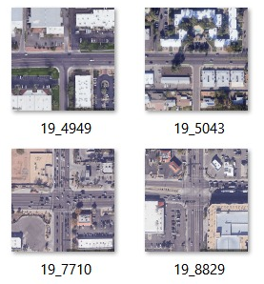
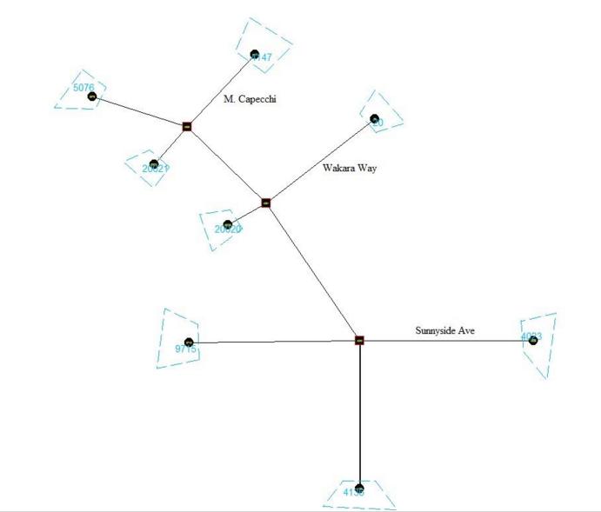
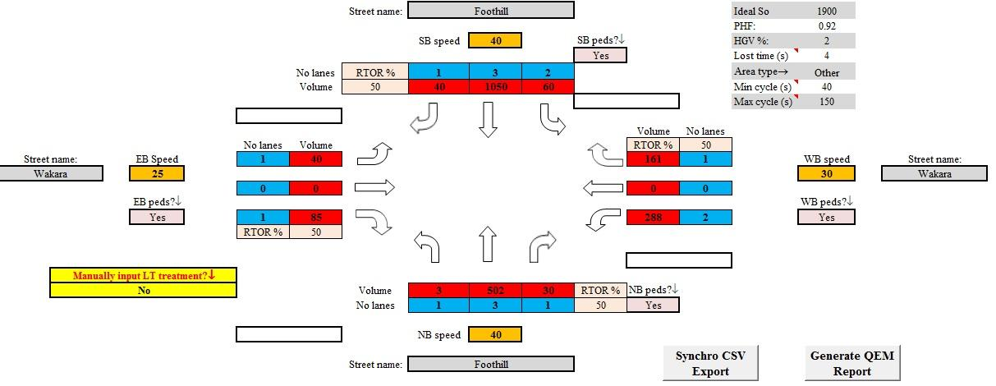
5.1 Traffic signal timing optimization
Excel-based and Python based
https://github.com/xzhou99/Sigma-X HCM-based computational engine for intersections
https://github.com/xzhou99/SignalAPI
The Intersection with ID
Sigma-X

Slide 36
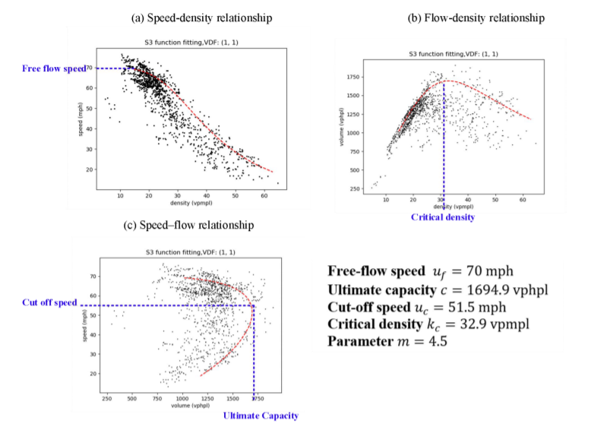
5.2. Freeway capacity analysis
https://github.com/xzhou99/VDF_calibration

Slide 37
5. Large scale applications

Slide 38
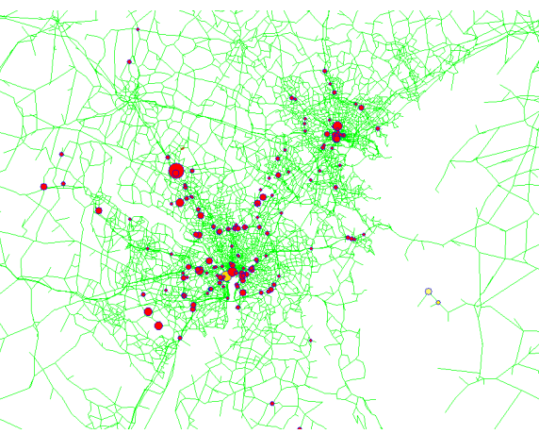
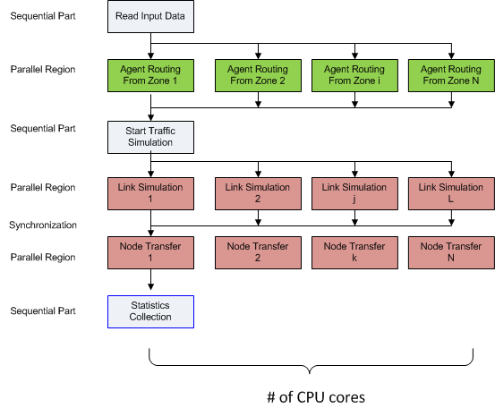
Computational Challenges
Shared memory-based parallel computing for agent-based path finding and mesoscopic traffic simulation (based on OpenMP)
Maryland State-wide model:
20 K nodes, 47K links, 3,000 zones, 18 M agents
CPU time: 30 min per UE iteration on a 20-core workstation with 194 GB RAM

Slide 39
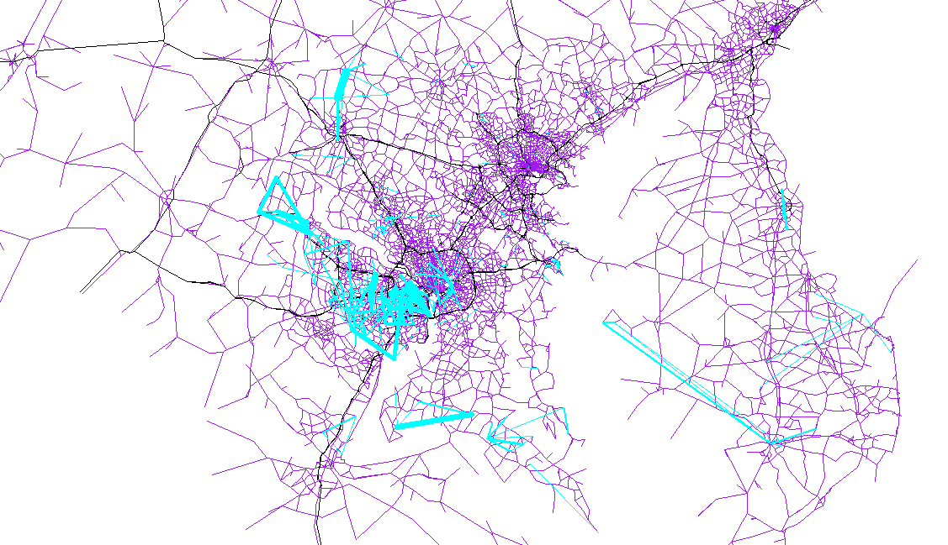
Origin-Destination Demand Spatial Distribution Pattern
Collaboration with University of Maryland and Maryland State Highway Administration
Supported by TRB SHRP II Program

Slide 40
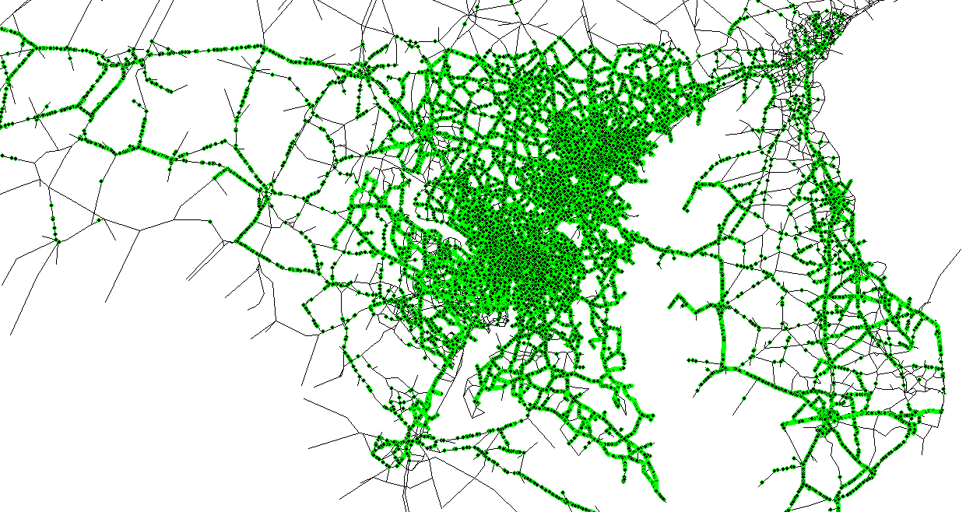
Vehicle Animation at Network Level

Slide 41
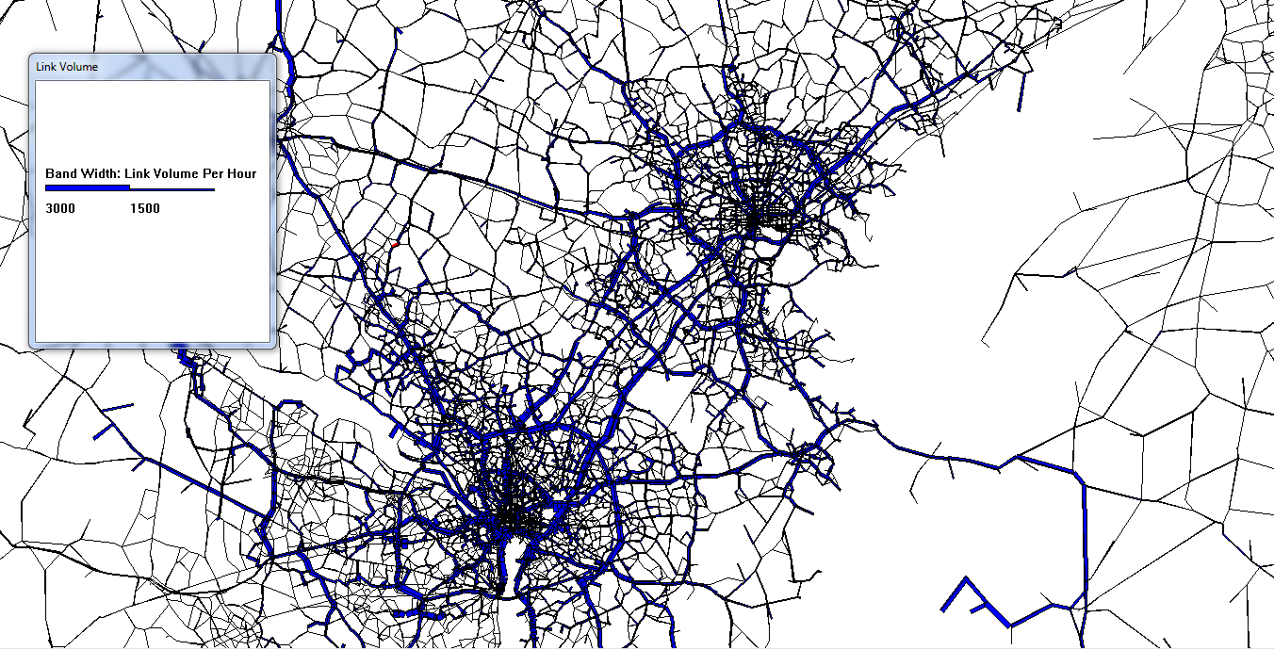
Volume at Network Level
Band width of a link is proportional to link volume

Slide 42
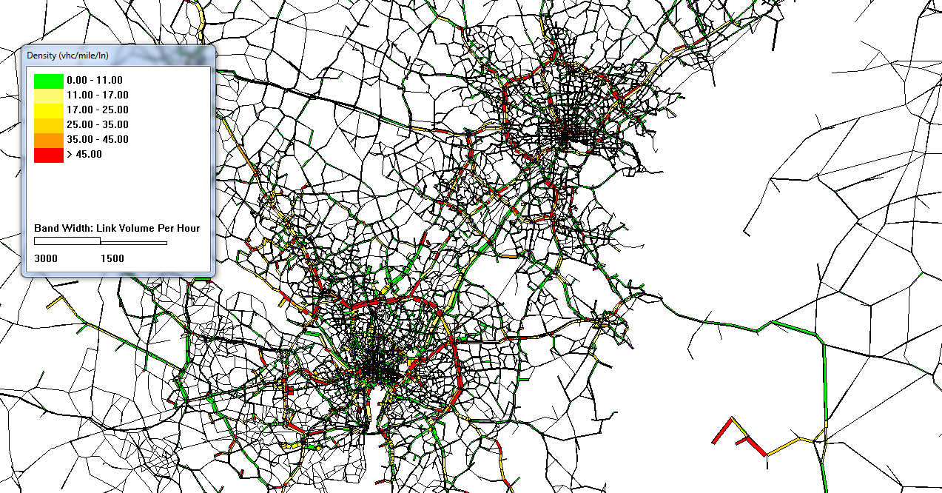
Density at Network Level

Slide 43
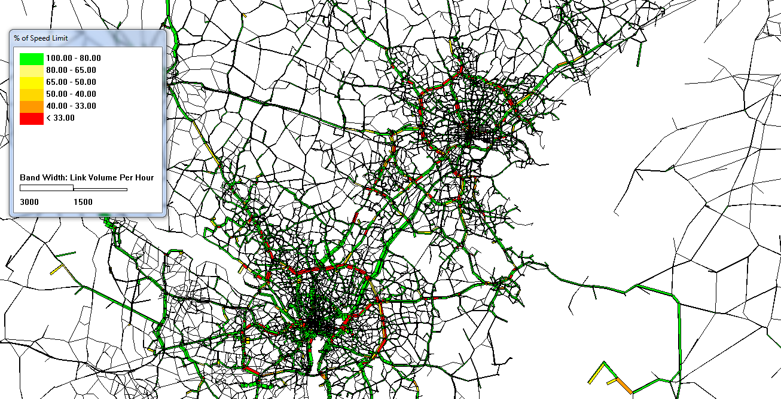
Speed at Network Level

Slide 44
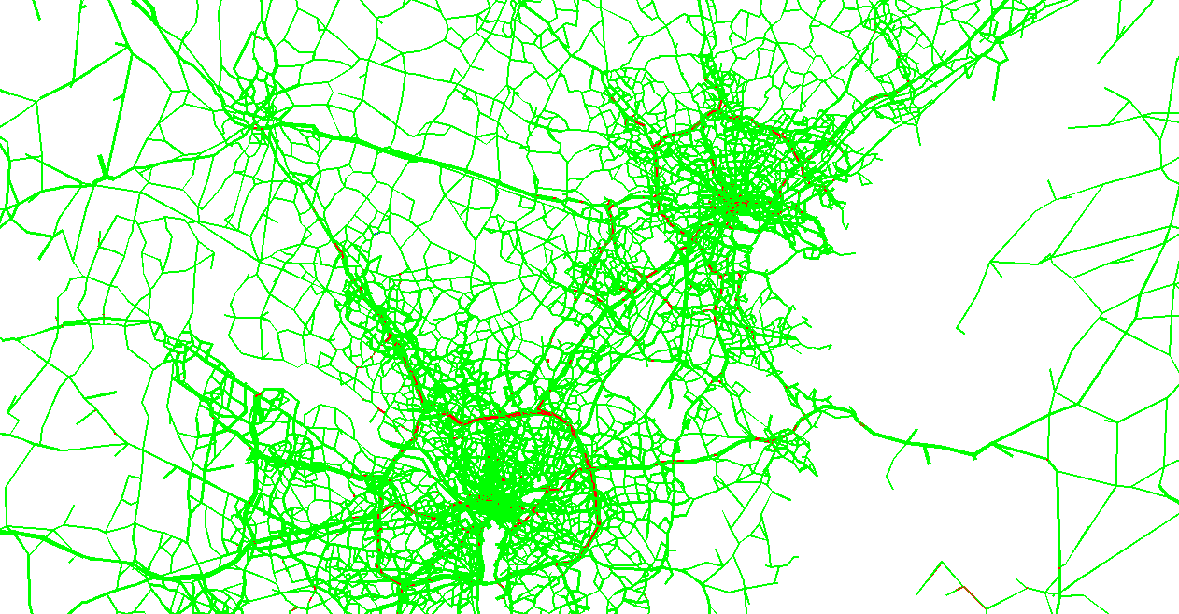
Queue at Network Level

Slide 45
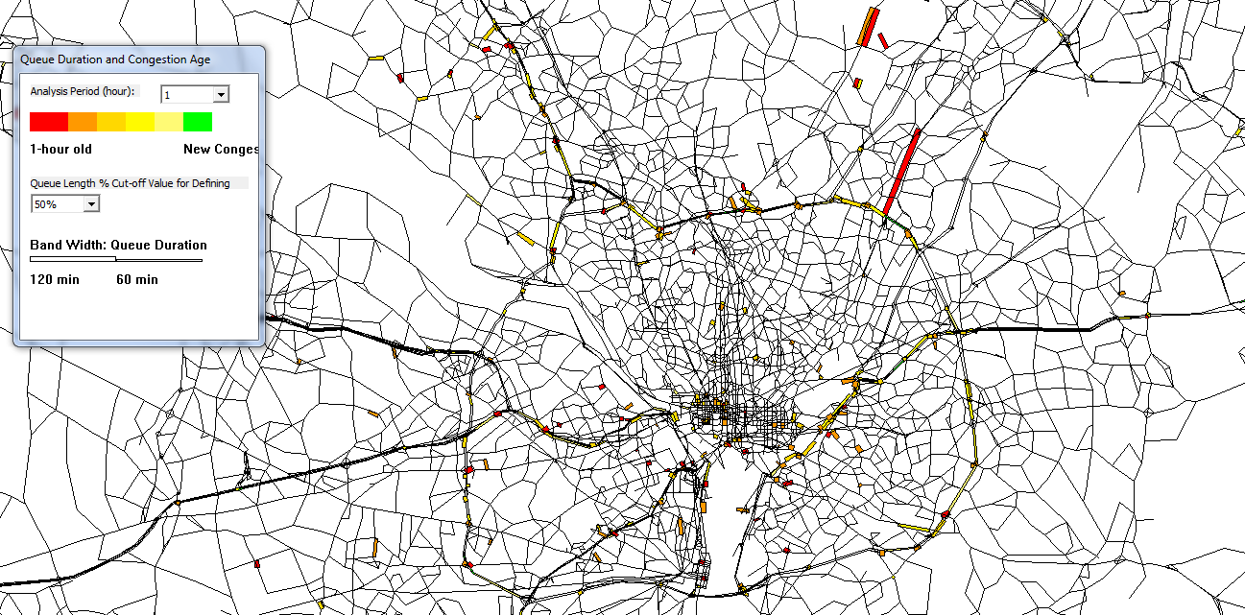

Queue Duration at Network Level
Link width represents duration of congestion (e.g. 60 min vs. 120 min)

Slide 46

Time-dependent Bottleneck Locations
Size of a circle represents the total delay at one node
Color of a circle represents the age of congestion (to identify the congestion propagation sequence)

Slide 47

Statewide Network Coverage in Google Earth

Slide 48
Connection 6: Optimization, Routing and Scheduling
Optimization
Transportation problem
Shortest path problem
Space time network design
Transit network design
Yard management
Vehicle routing problem
Train scheduling
Customized bus service design
https://github.com/xzhou99/learning-transportation/tree/master/GAMS_code%20-space-time-network
VRPLite
https://github.com/xzhou99/VRPLite
DTALite-S: for multimodal transportation simulation
https://github.com/xzhou99/DTALite-S
Big Data
Multimodel Optimization
&
Scheduling and Routing
Highway Capacity & Signal Timing Models
Micro-simulation Models
Traffic Stream Model &Dynamic Assignment Models
Travel Demand Forecasting Models
AMS Data Hub

Slide 49


6.1 Learning Nework Flow Models based on GAMS
https://github.com/xzhou99/learning-transportation/tree/master/GAMS_code%20-space-time-network

Slide 50


6.2 From space-time diagram to space-time networks
https://github.com/xzhou99/space-time-diagram_gmns
https://github.com/xzhou99/learning-transportation/tree/master/GAMS_code%20-space-time-network

Slide 51

6.3 From space-time network to space-time-state network in vehicle routing
https://github.com/xzhou99/VRPLite
https://link.springer.com/article/10.1007/s40864-018-0083-7
https://github.com/xzhou99/learning-transportation/tree/master/GAMS_code%20-space-time-network

Slide 52

6.4 Use space-time network in multimodal system scheduling
https://github.com/xzhou99/learning-transportation/tree/master/GAMS_code%20-space-time-network

Slide 53

6.5 Automated vehicle scheduling based on space-time networks
https://github.com/xzhou99/learning-transportation/tree/master/GAMS_code%20-space-time-network
https://github.com/xzhou99/AVRLite

Slide 54



6.6 Travel demand and activity modeling based on space-time-state network
https://github.com/xzhou99/learning-transportation/tree/master/GAMS_code%20-space-time-network

Slide 55
Summary of related open-source tools
Simulation-based mesoscopic dynamic traffic assignment
DTALite(based on simplified kinematic wave model)
Simulation-based mesoscopic dynamic traffic assignment
STALite
visualization interfeace
NEXTA
Traffic state estimation and prediction, Train routing and scheduling
VRPLite

